Slide 1
Printing Setup
Fitzalan High School

Slide 2
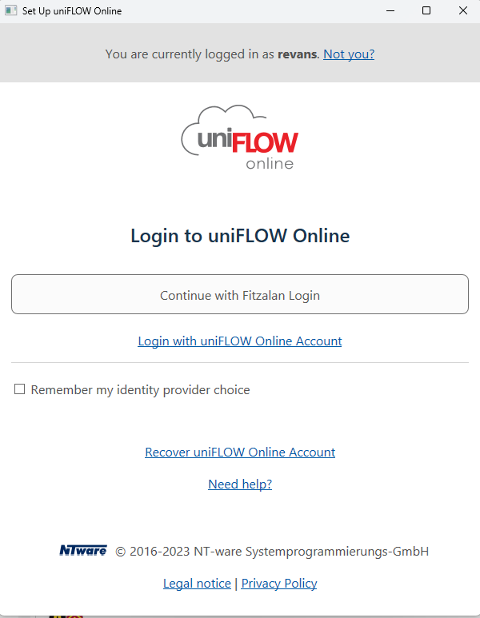
When you sign onto a computer you will see this pop up
Click Continue with ‘Fitzalan Login’. This will open a browser where you sign in using your Fitz email
Please tick remember my identity!

Slide 3
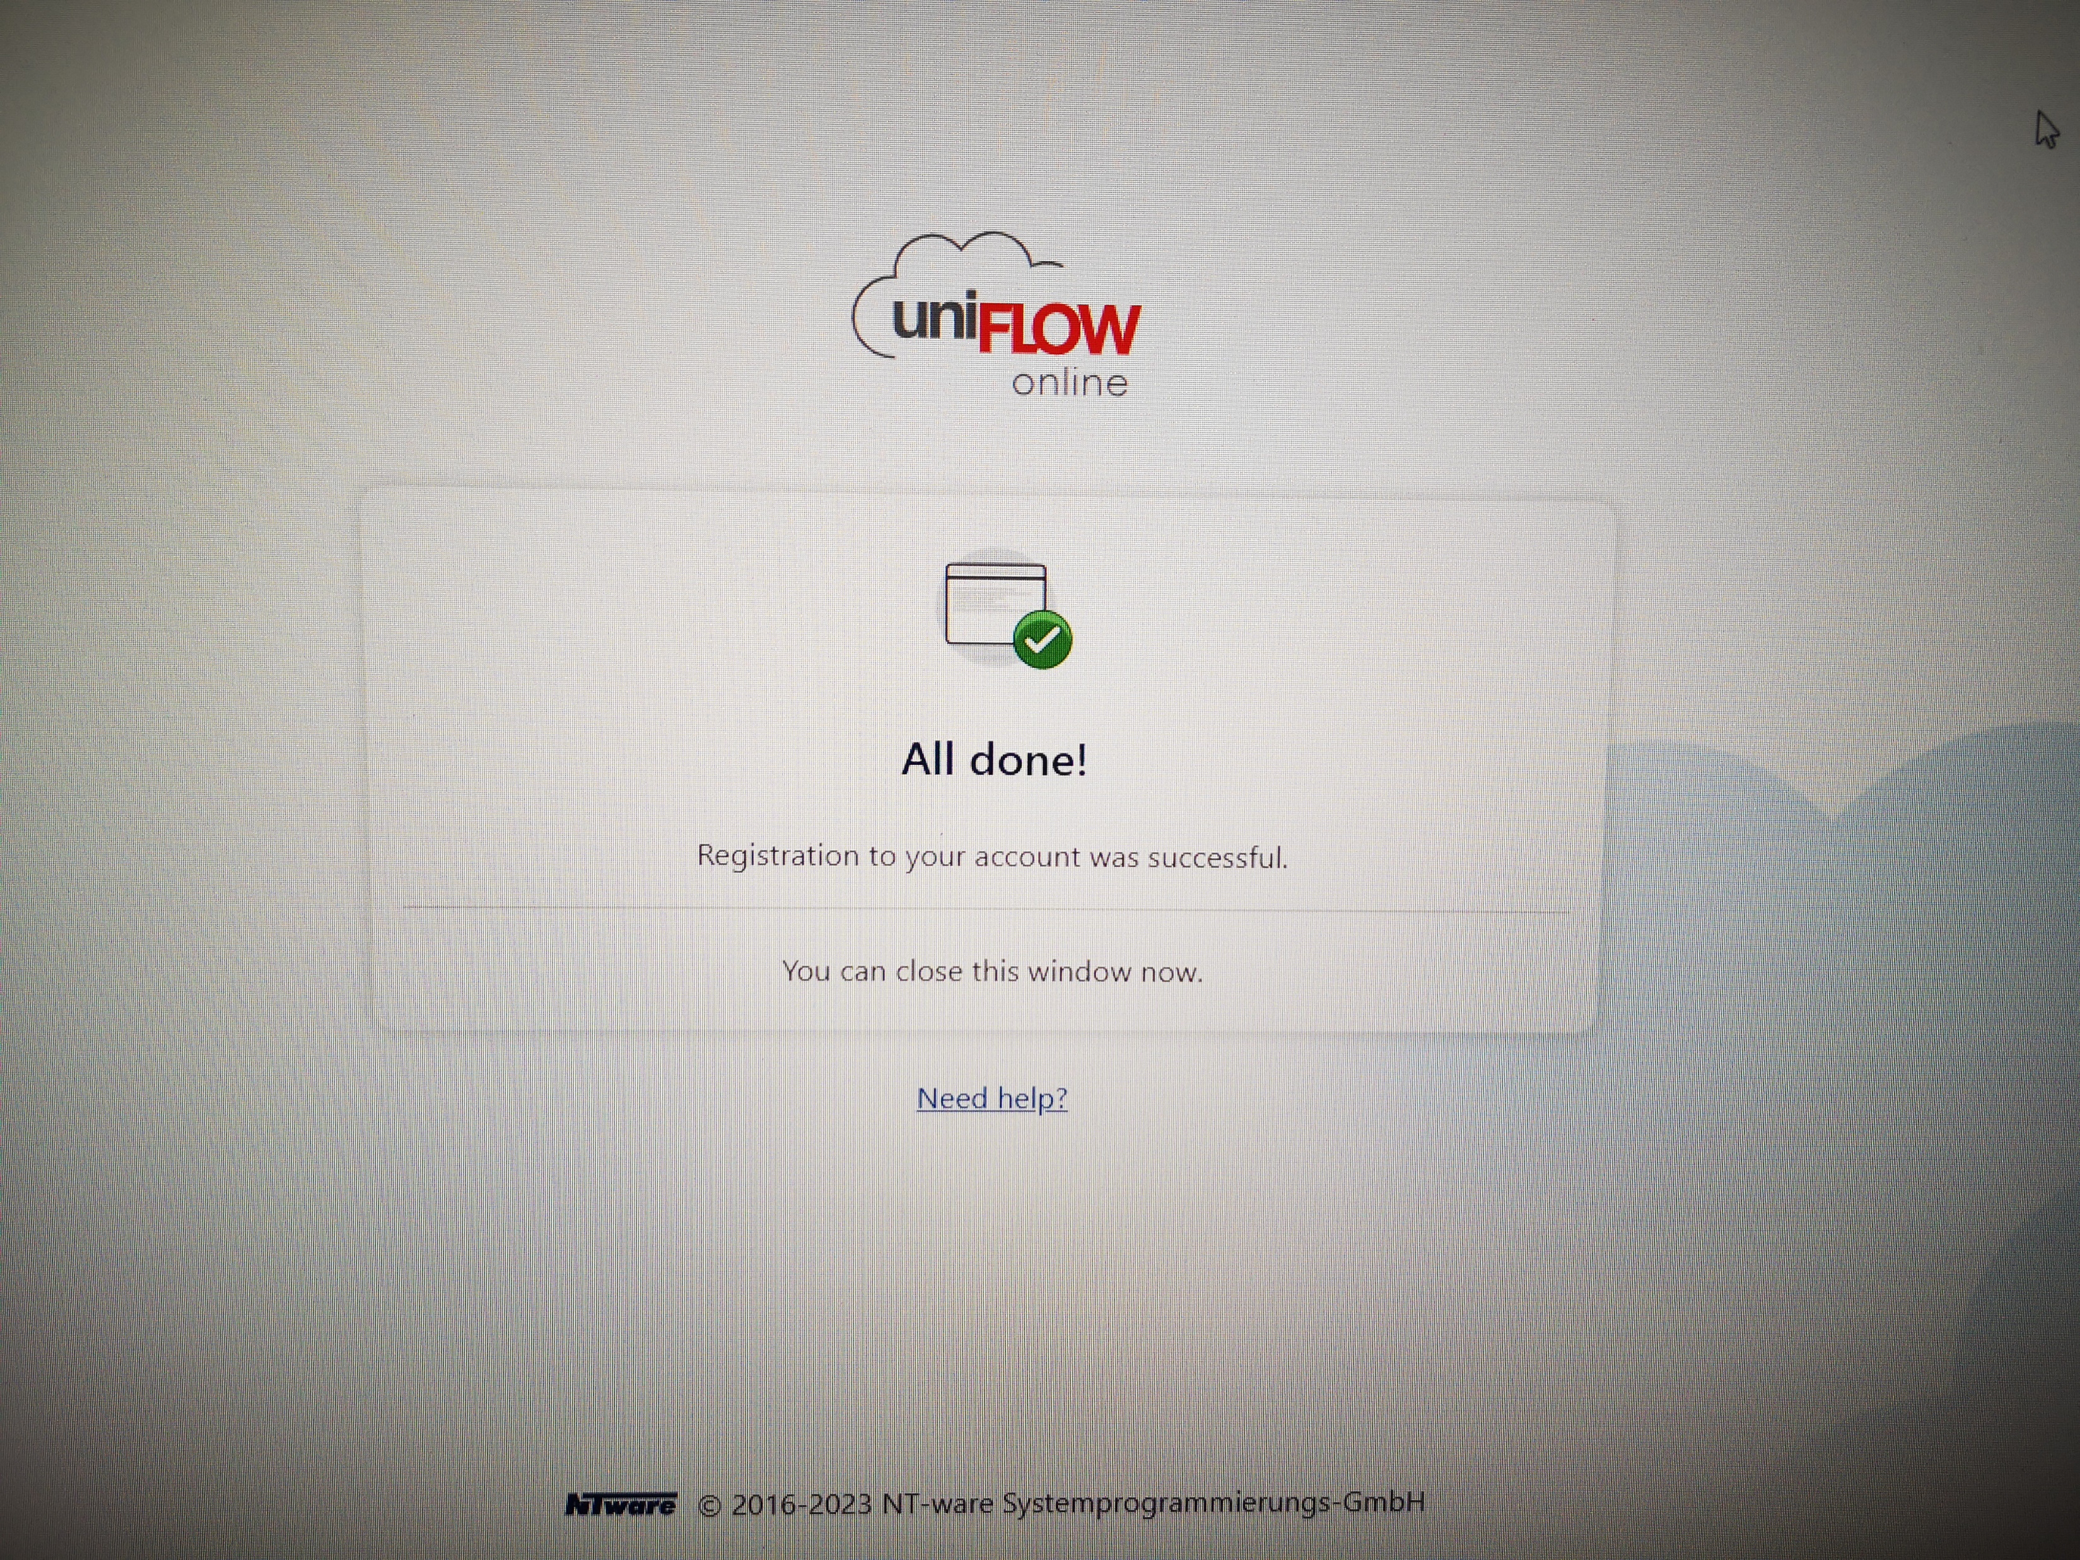
You will see this message once the account has been registered

Slide 4
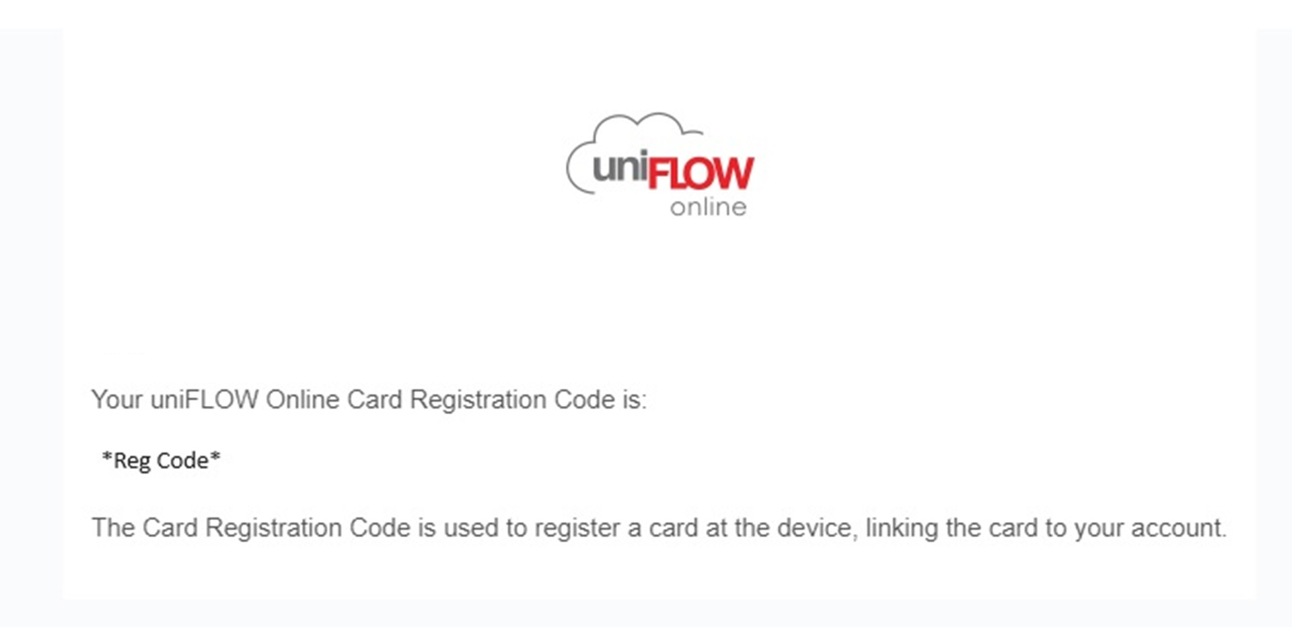
You will receive 2 emails. One with your registration code
You will have received 2 emails. One with you registration code
This is for registering your card on a printer!

Slide 5
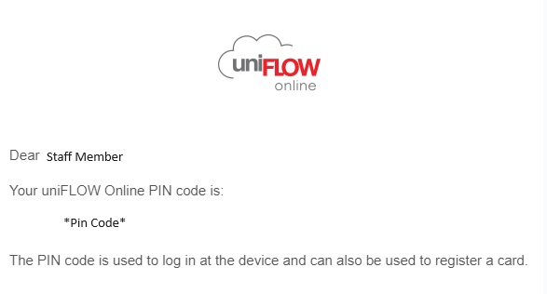
Another email with your pin code
This code is for use of printers if you do not have your card with you

Slide 6
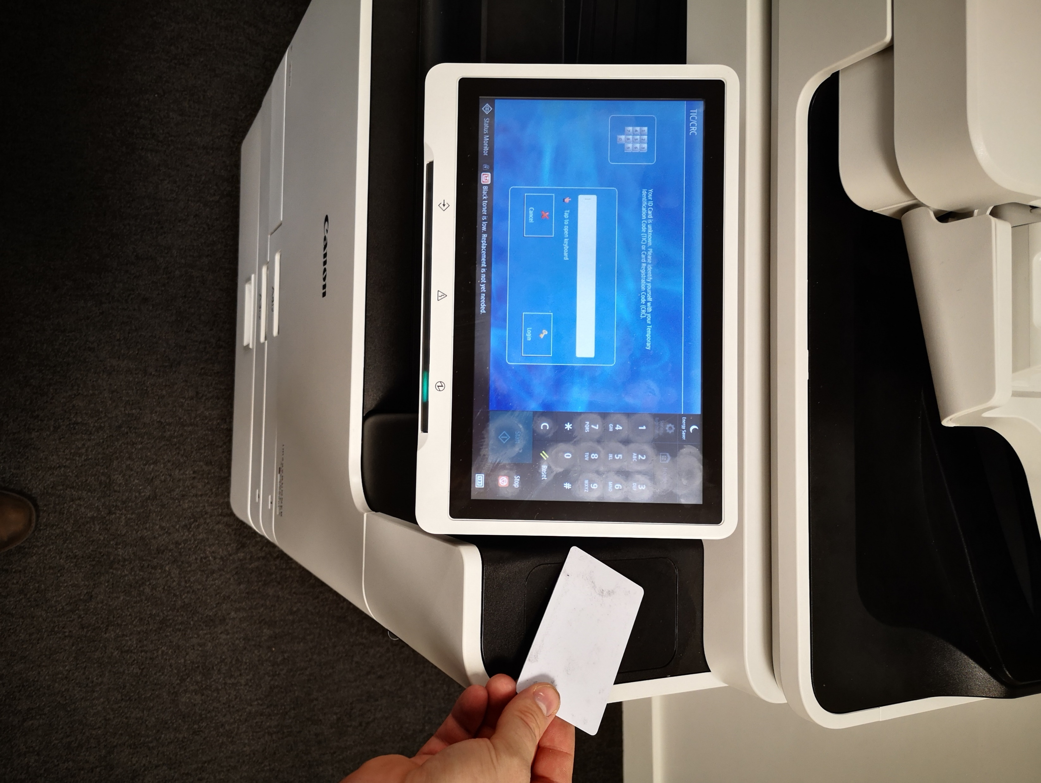
Take your card to a printer and tap it as seen in this photo

Slide 7
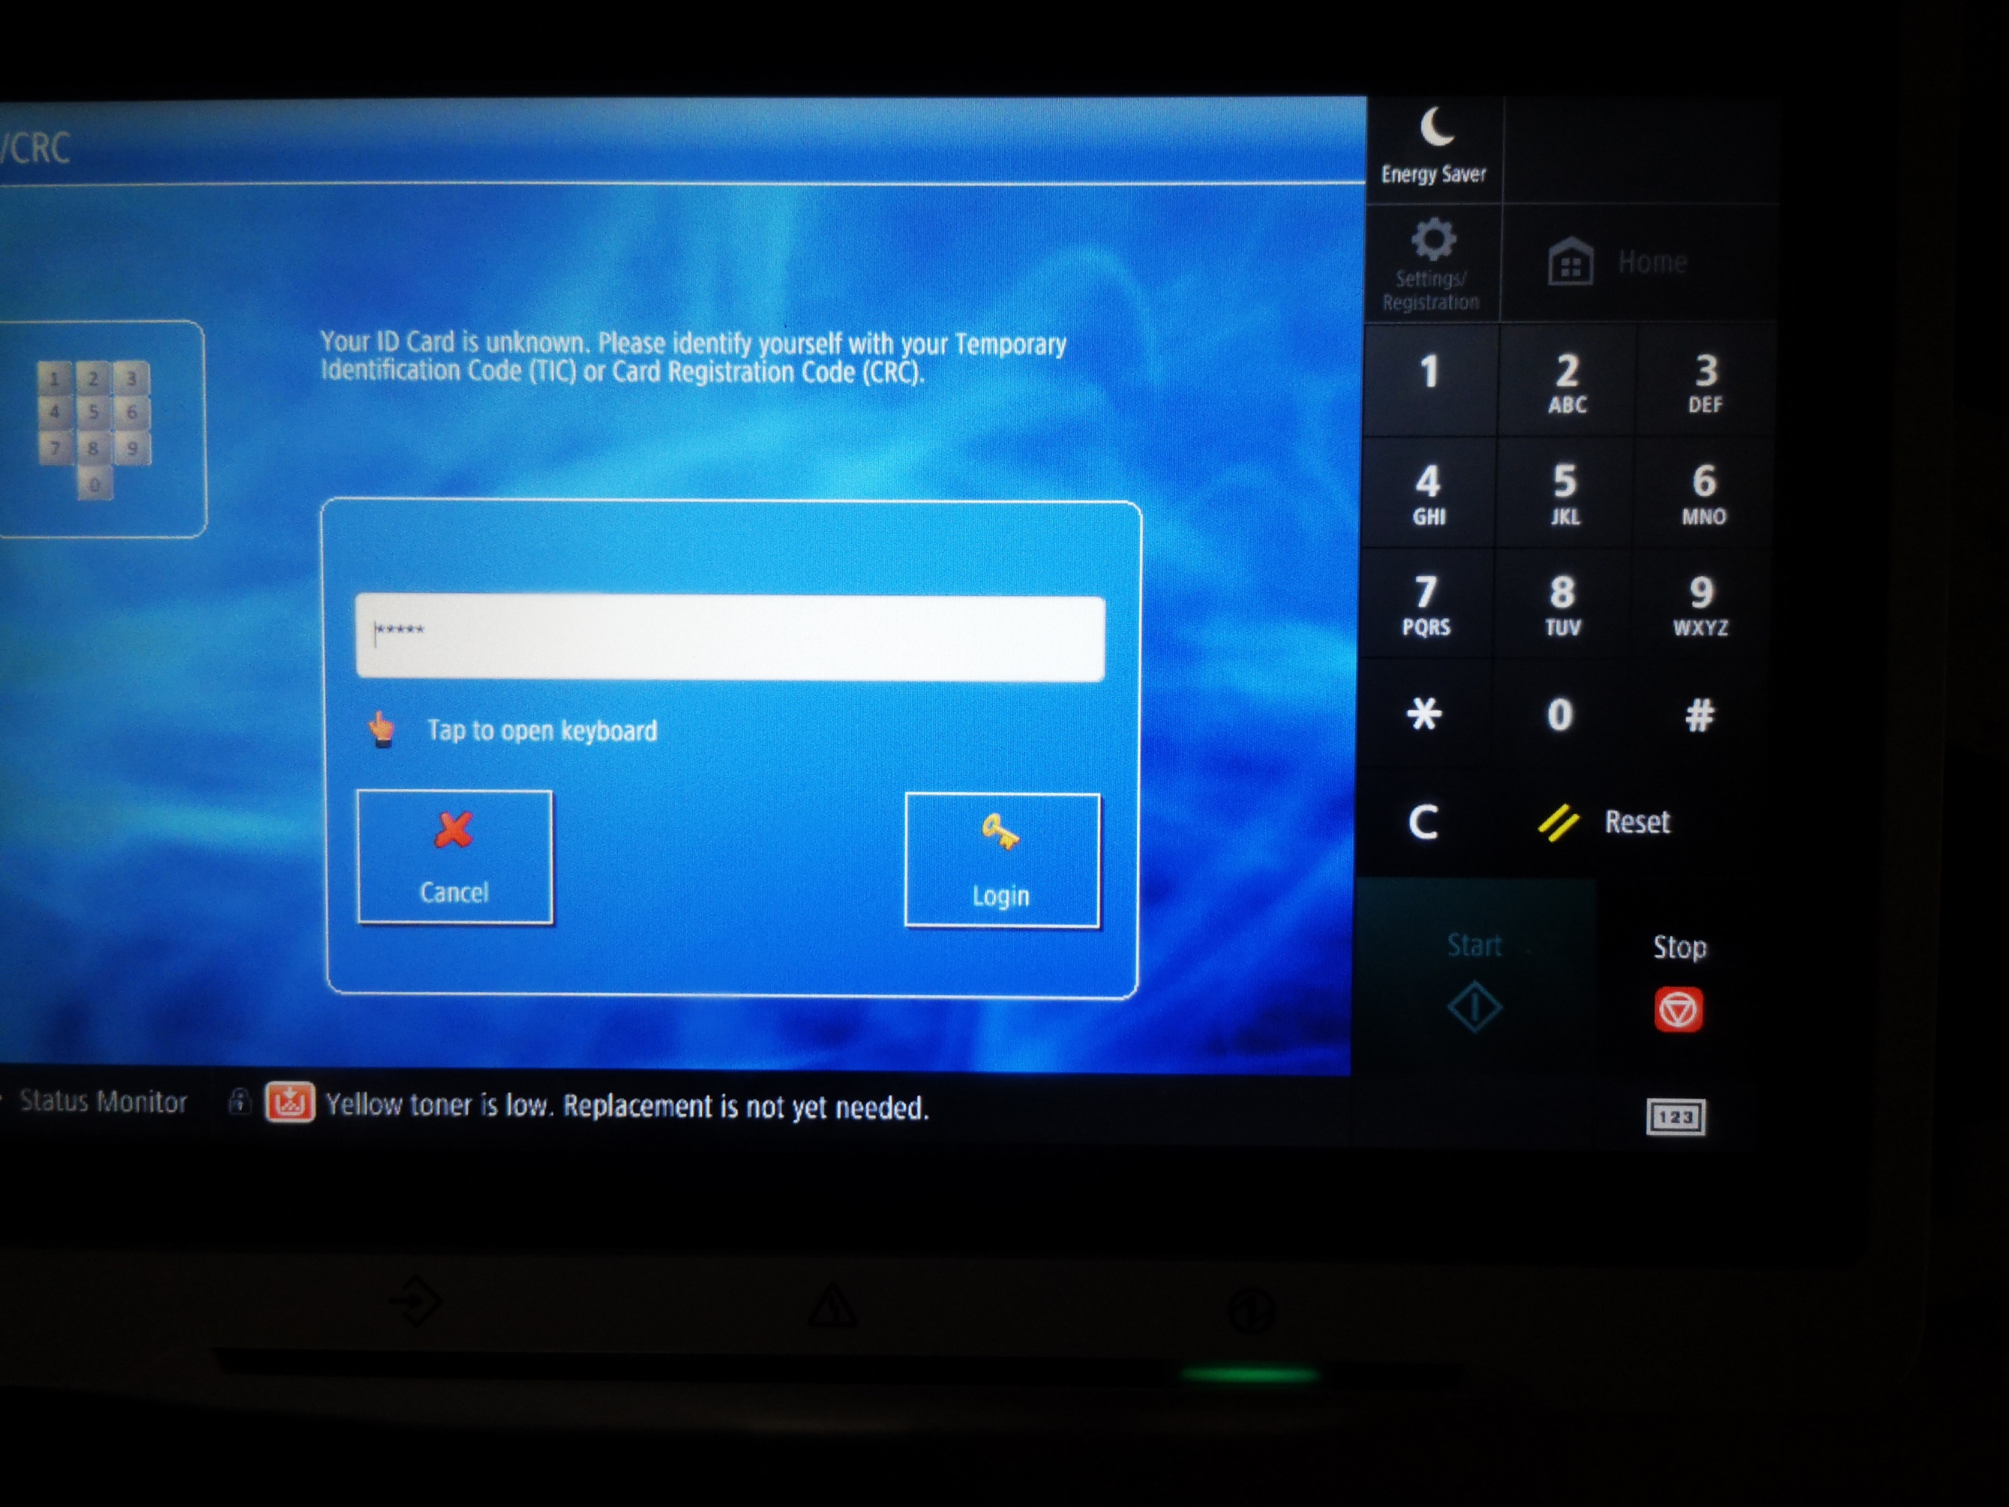
Enter the REGISTRATION CODE sent to you via email

Slide 8
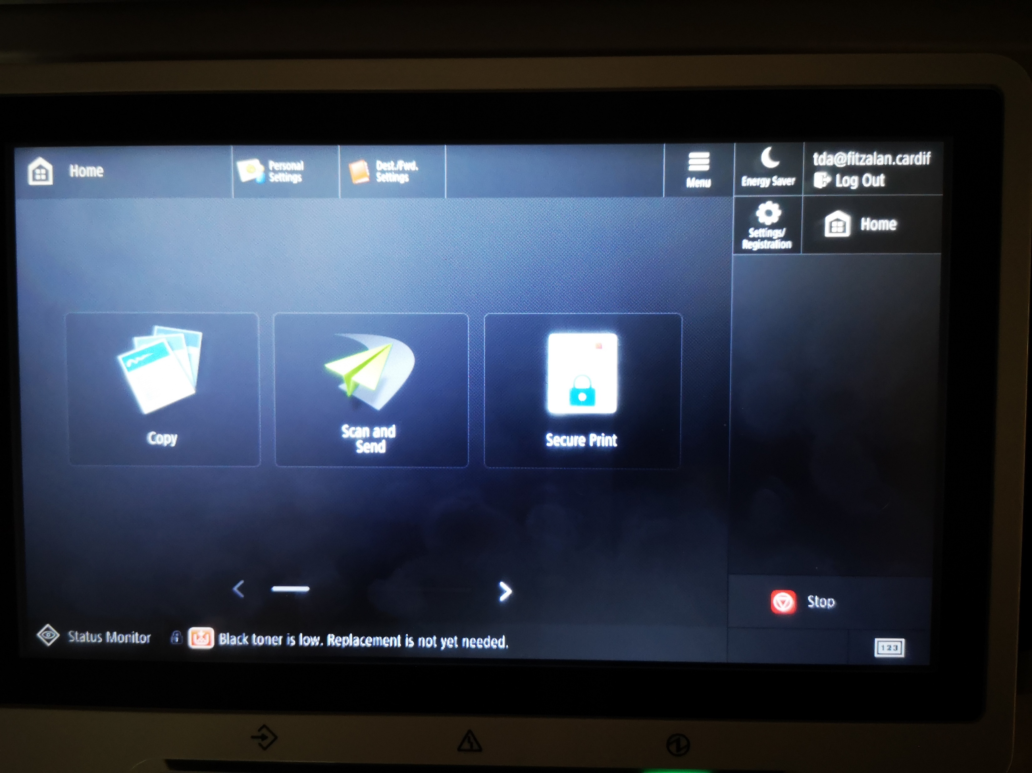


Slide 9
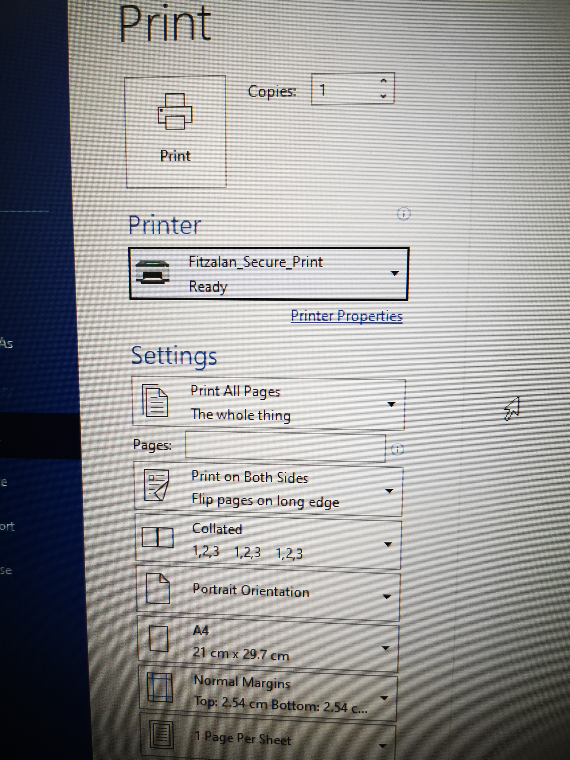
When you need to print. The printer you need to select is ‘Fitzalan_Secure_Print’
You can now go to your closest printer or any other printer and tap your card OR enter your PIN CODE emailed to you

Slide 10

Once you have tapped your card. Select Secure Print.
Whenever you print to ‘Fitzalan_Secure_Print’ all your files are sent to a print queue on a print server. Ready to be printed when you arrive and select them at the machine

Slide 11
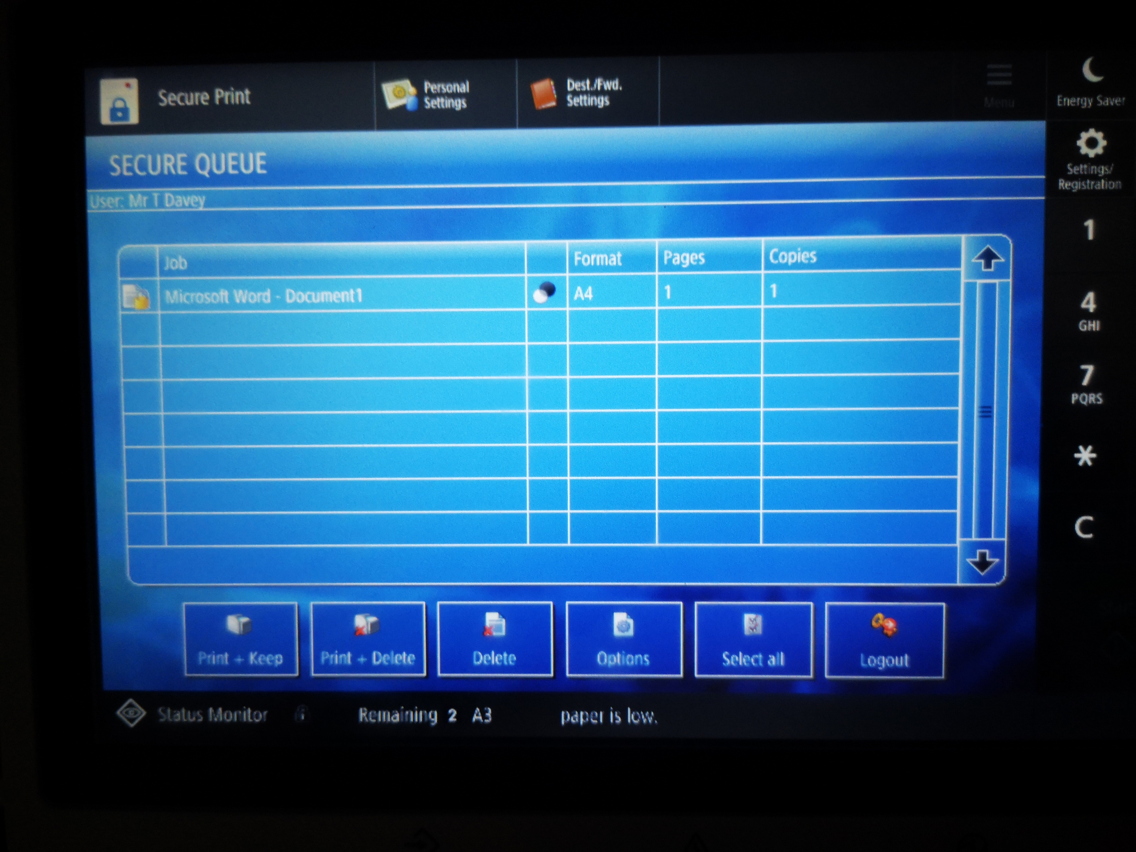

Here you will see the your personal print queue listed.
Select the job you would like to print
The option Print+Keep will leave the files in your queue for later use
The Print+Delete option will print your job and then remove it from your secure queue.

Slide 12
If you have any questions or need any assistance. Please contact the IT department

