Slide 1
School VPN Access

Slide 2
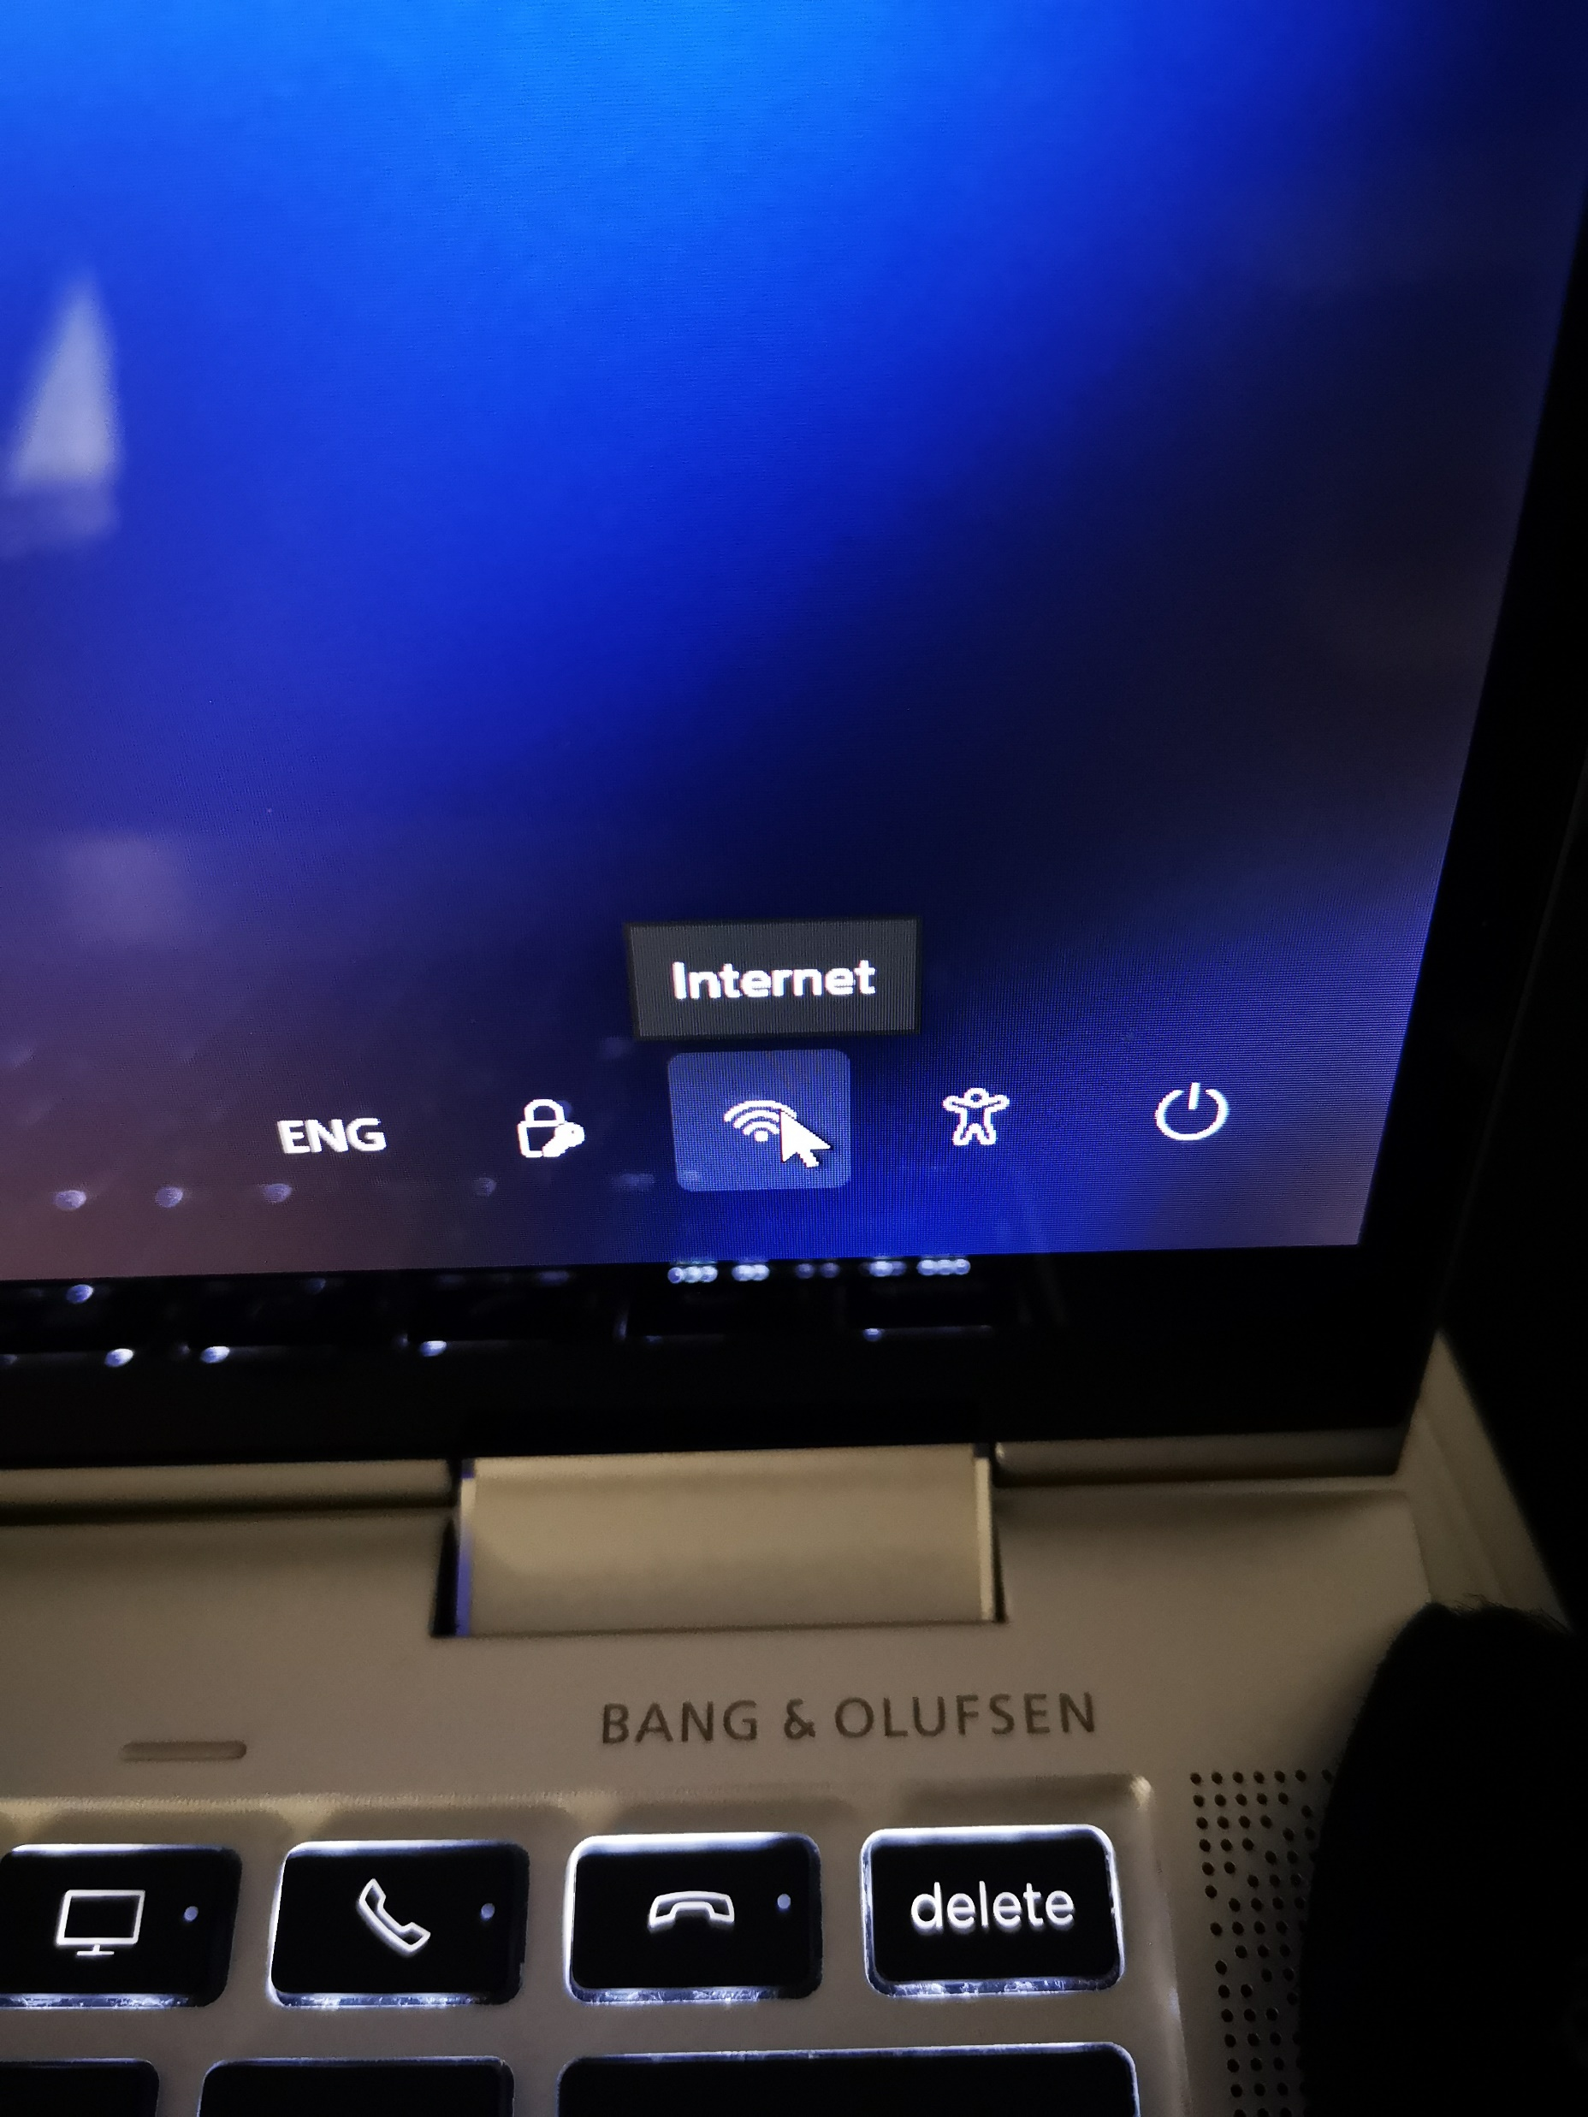
Make sure you are connected to your home WiFi

Slide 3
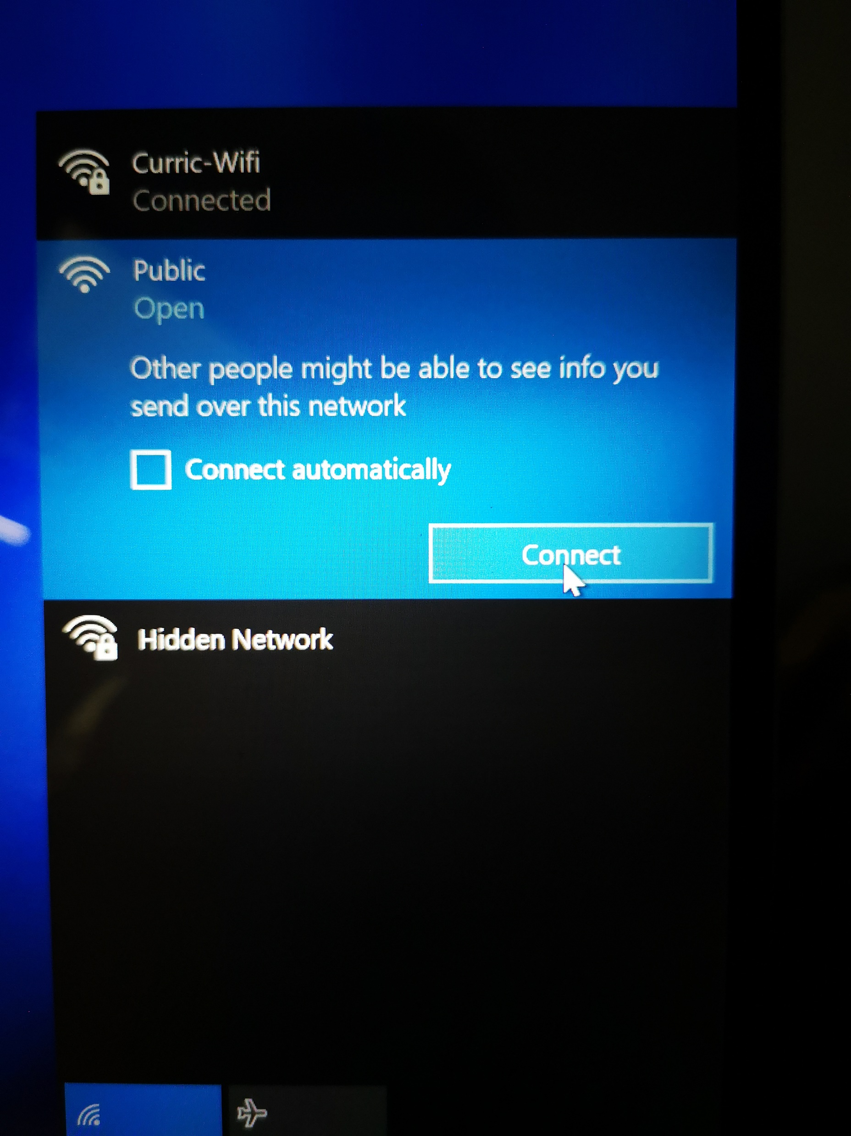
This will be your WiFi outer name

Slide 4
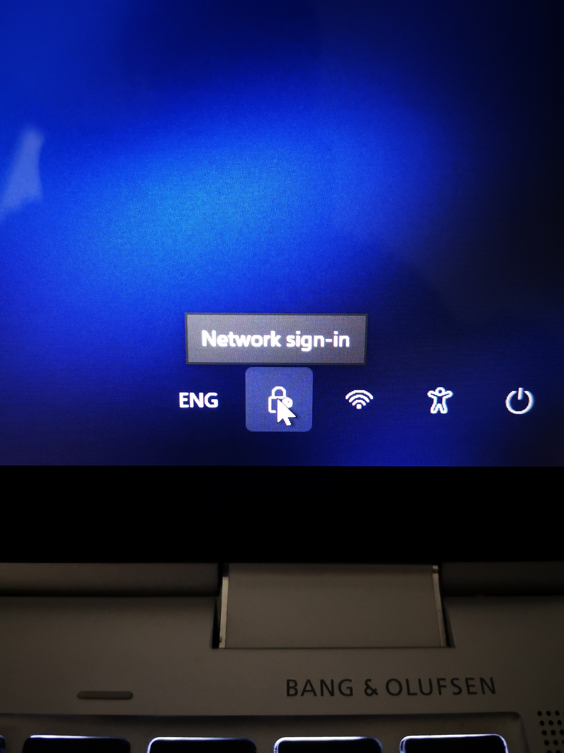
Click on the network sign-in icon

Slide 5
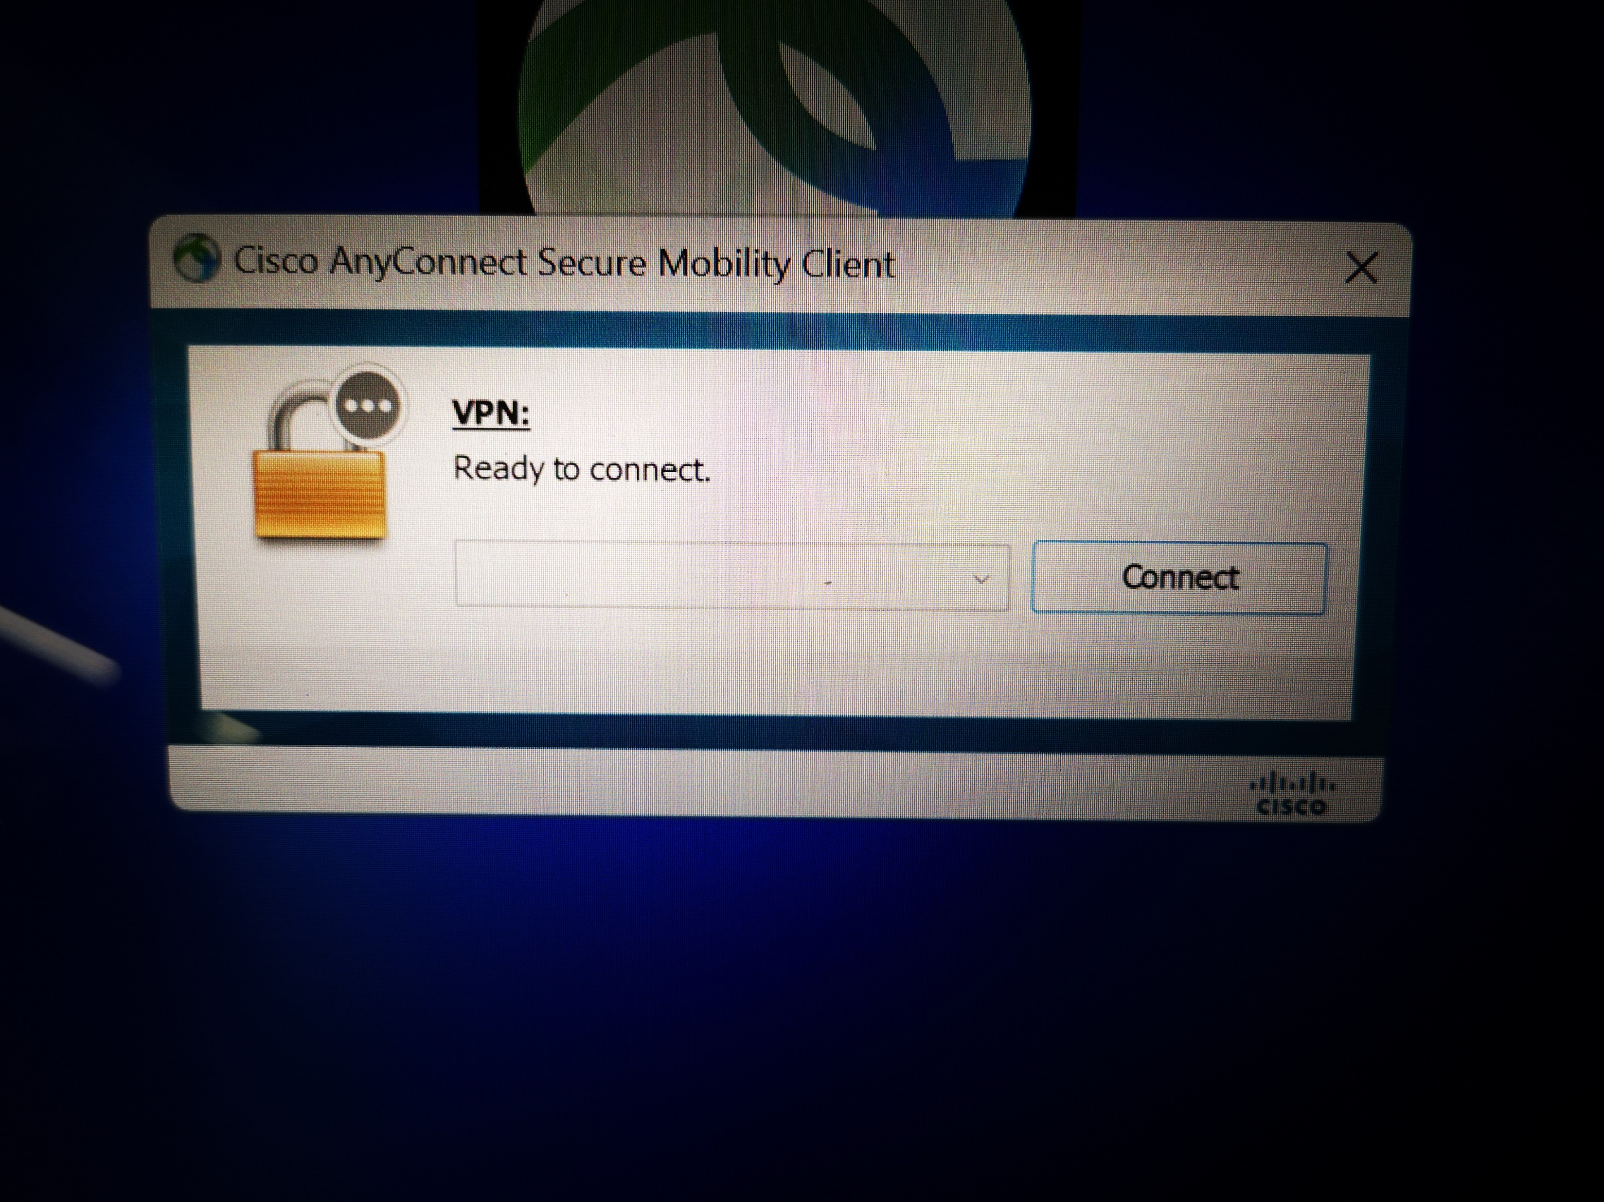
This box will pop up. You will need to fill this box with schoolsra.Cardiff.gov.uk

Slide 6
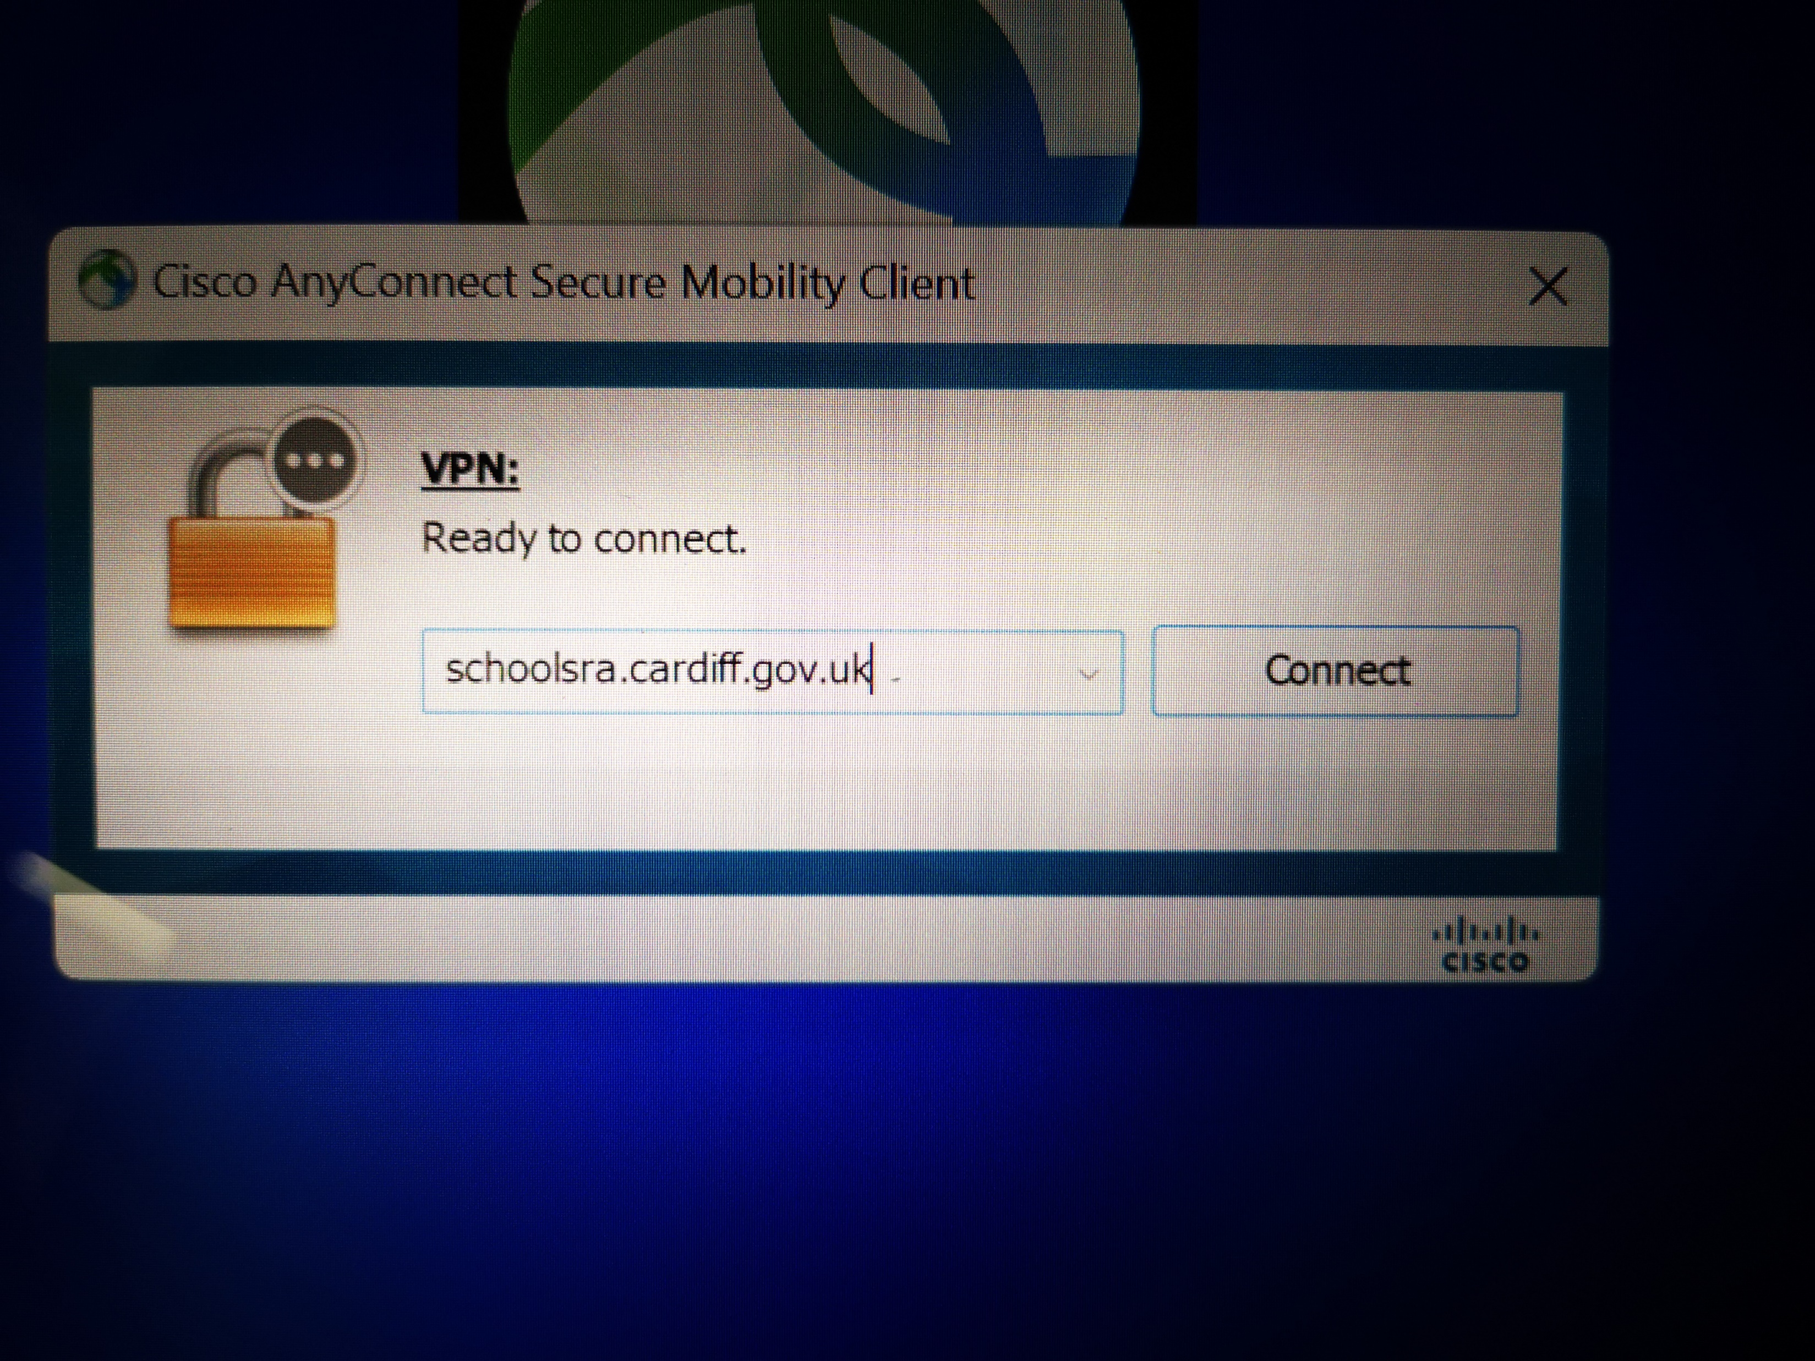
Click connect

Slide 7
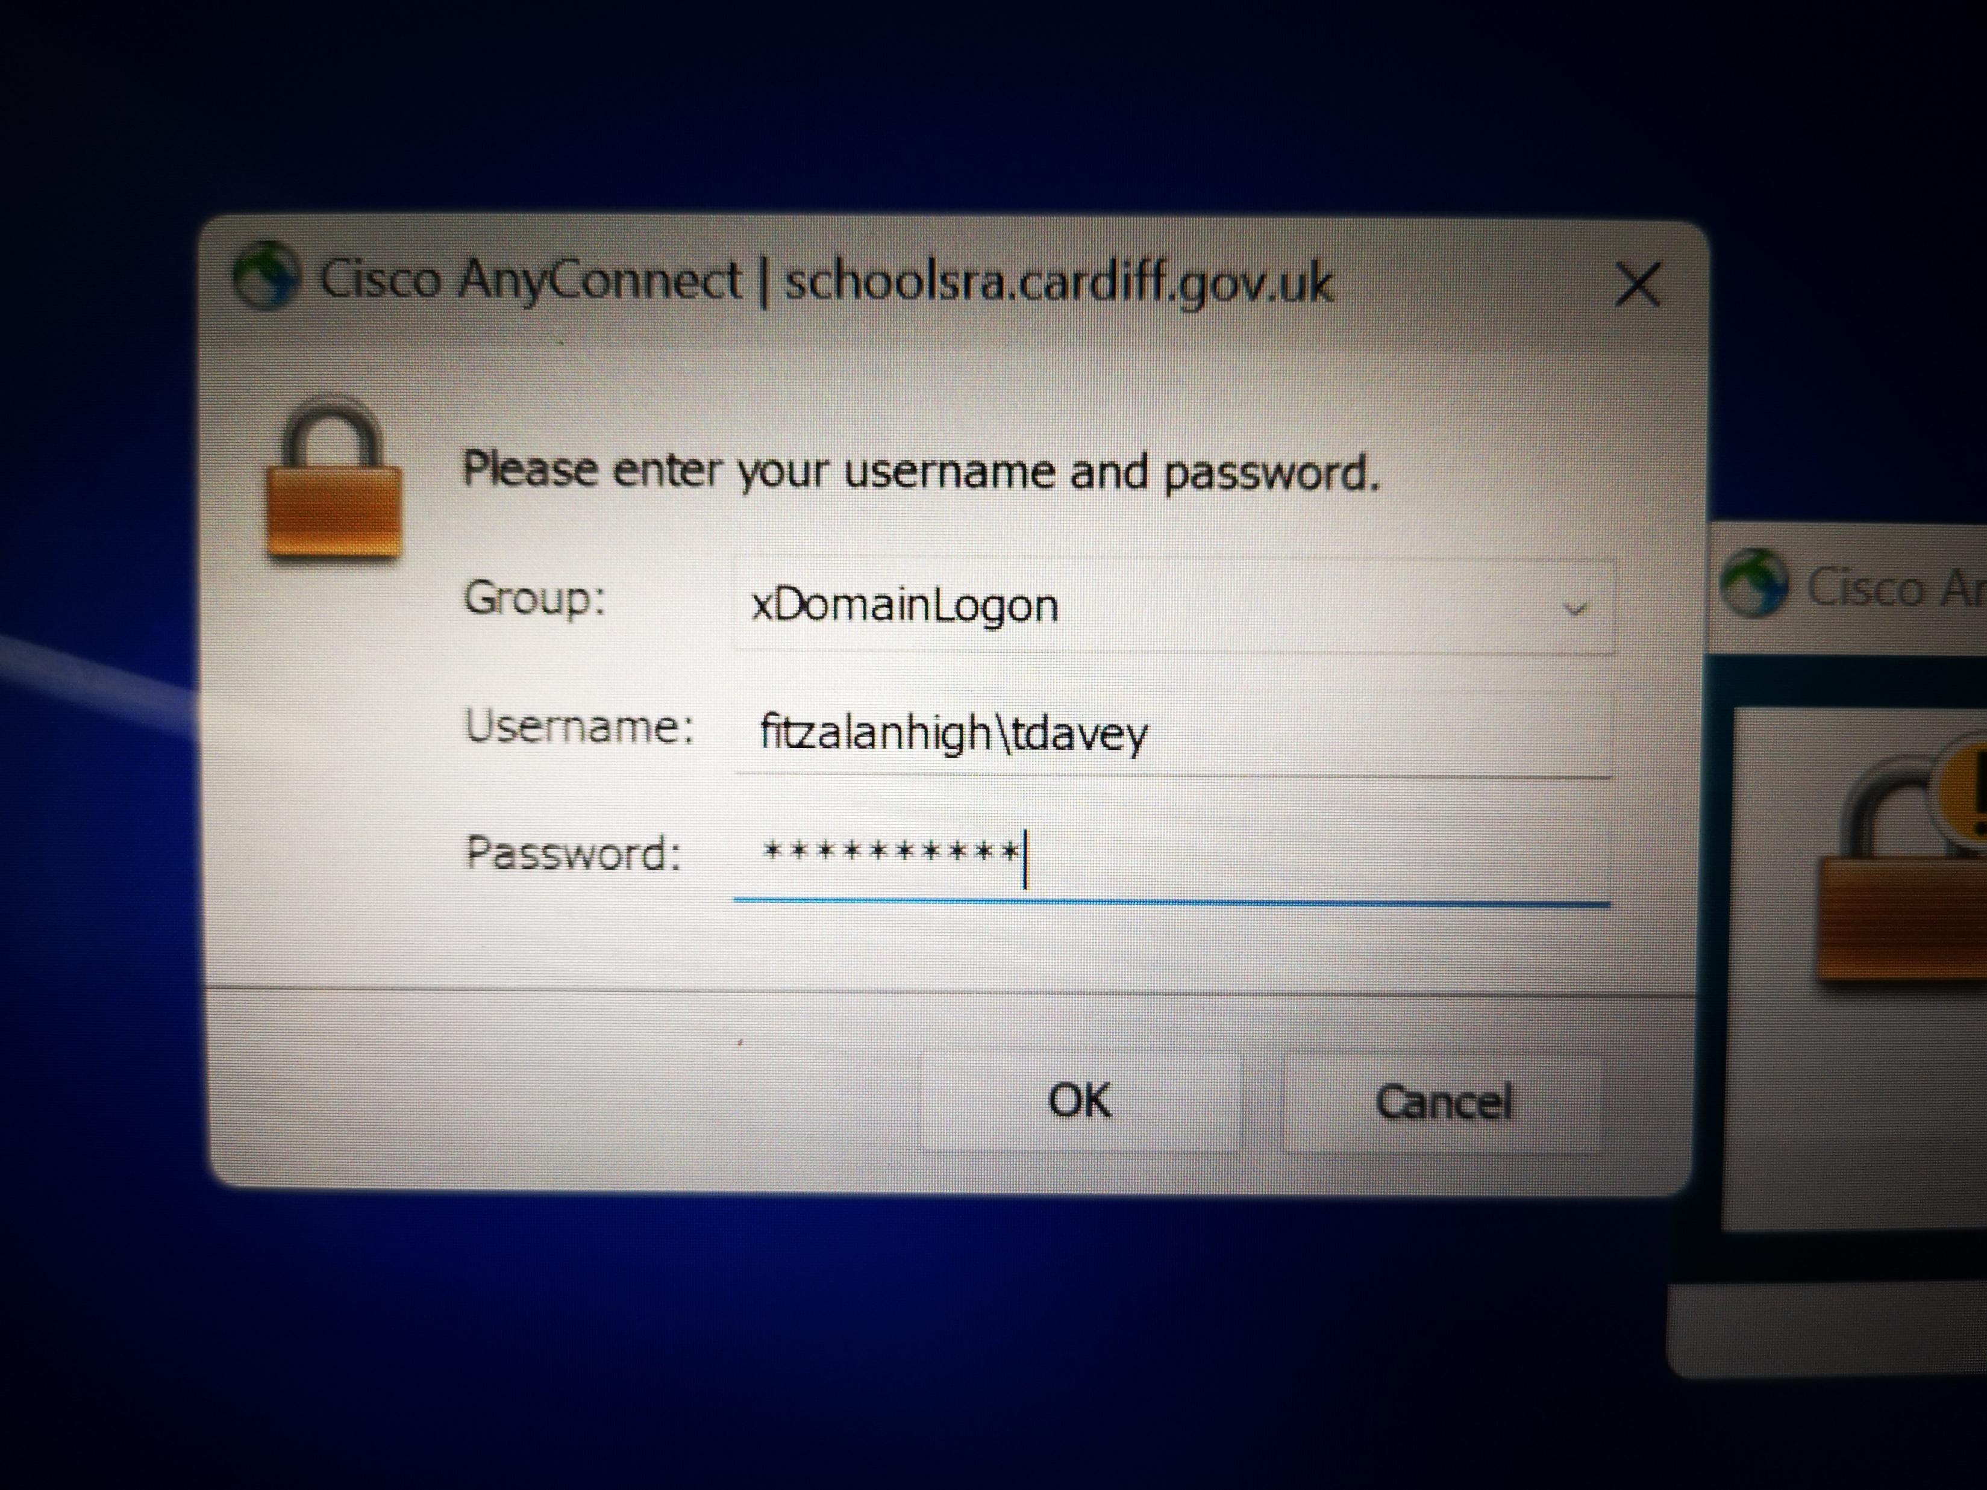
Here you need to fill out your username and password as seen in the image
The username box needs to start with fitzalanhigh\*Your Network Username*
Then enter your network log in password. These credentials are the same as what you use on computer in school.

Slide 8
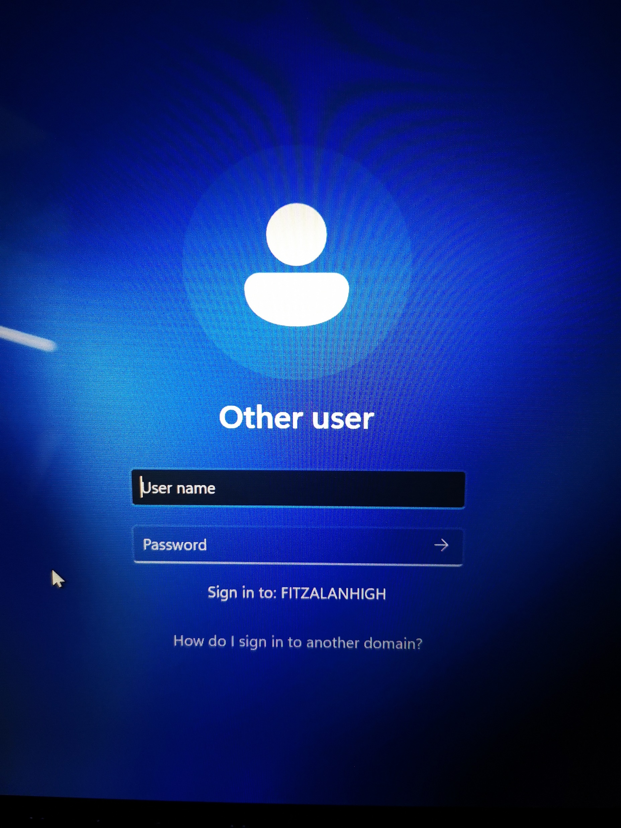
You will then see this log in screen. Proceed with your usual log in details as you would at school

Slide 9
If you have any issues or questions. Please contact us via the Help Desk

